Slide 1
Apparel Tech Pack Discussion
Jessica Raushel and Andrew Strohmetz
March 18th, 2025

Slide 2
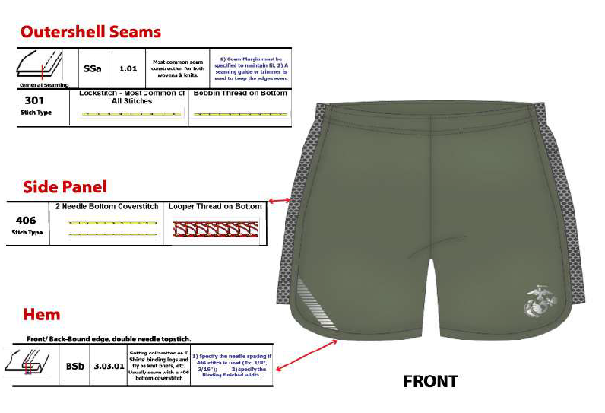
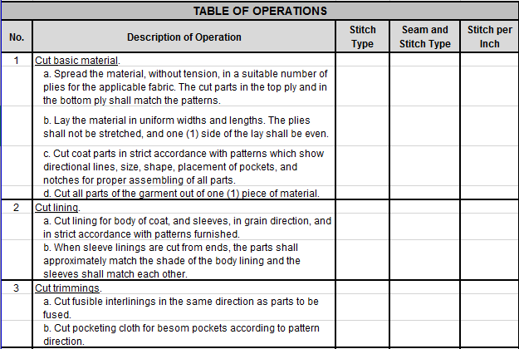
What is an Apparel Tech Pack (ATP)?
Visual, comprehensive, and technical blueprint for garment construction
Some industry partners currently translate DoD Specifications and Purchase Descriptions into Apparel Tech Packs
Apparel Tech Pack Development in DoD C&T Community is driven by future state vision of a PLM System used by the Services, DLA, and industry partners
USMC PT Uniform
USSF Coat, Man’s Service Dress
Distribution Statement A. Approved for public release: distribution unlimited.

Slide 3
ATP Tiger Team Timeline
Full Adoption of End Item ATPs at DLA C&T
Army ARTC ATP w/ SRP
ATP Continuous Improvement
Navy IPTU ATP solicitation – industry feedback
2025 Navy IPTU ATP w/SRP
June 2024 Tiger Team Roster est.
Sept 2024 DLA C&T Contracting PLM Demo
April 2024 DLA C&T TQ PLM Demo
Approval of ATP Tiger Team Mission Statement
Distribution Statement A. Approved for public release: distribution unlimited.

Slide 4
Our Request from Industry
As we work toward future state, ATPs will be exported and provided as .PDF files in selected upcoming solicitations
During Market Research phase, please provide ample feedback to Apparel Tech Packs to contracting and quality assurance team(s)
DLA will communicate feedback to the Services, continuously improve, and ultimately prepare ATPs for adoption with Defense Standardization Program
Feedback is welcome prior to the release of the first ATP – if there are any features or suggestions you would like to see, please let us know
Please provide feedback on C&T ATPs to:
Jessica.Raushel@dla.mil
Andrew.Strohmetz@dla.mil
Distribution Statement A. Approved for public release: distribution unlimited.

